Slide 1
Deep Learning

Slide 2
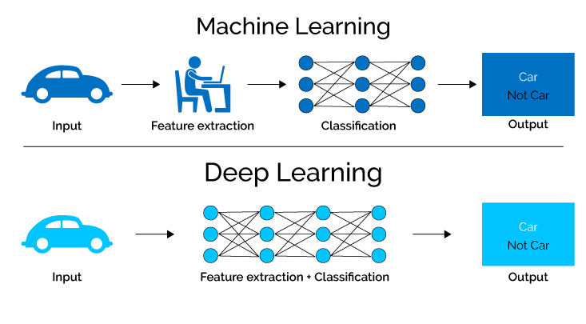

Slide 3
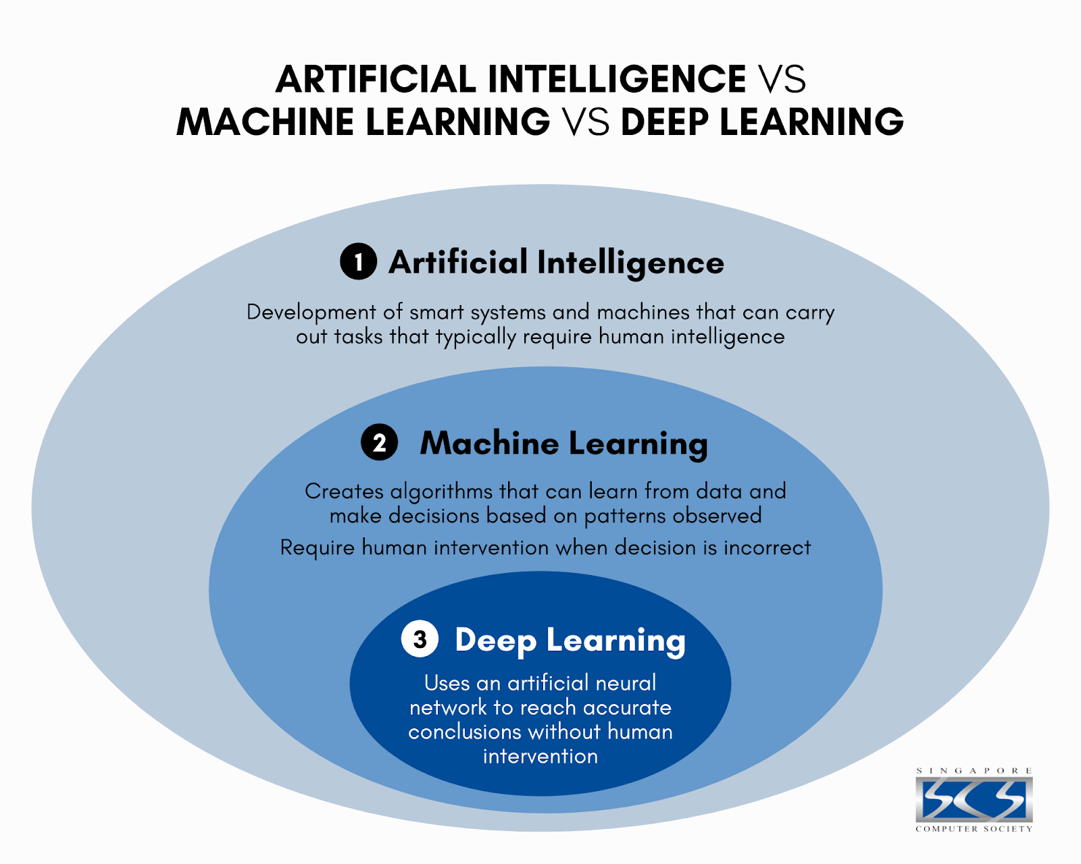

Slide 4


Slide 5
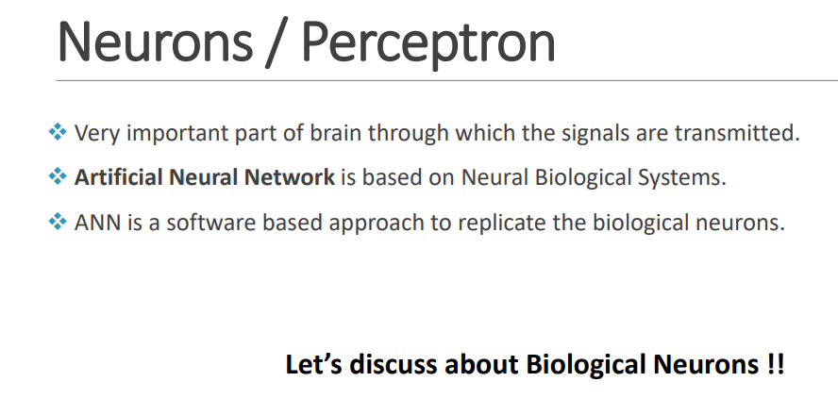

Slide 6
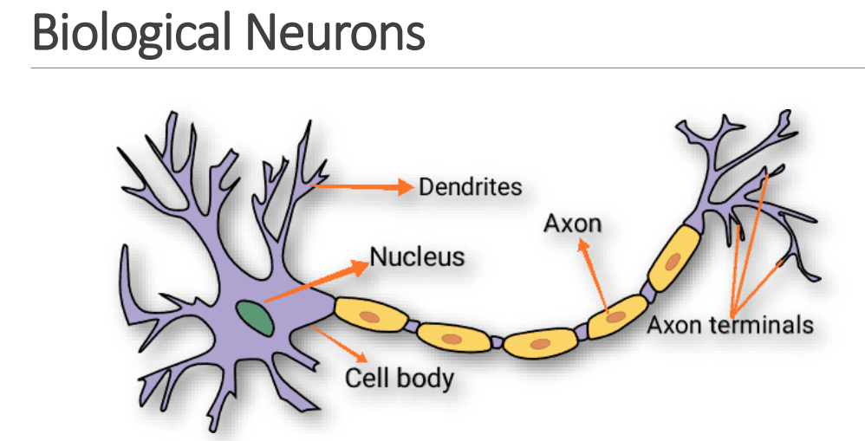

Slide 7
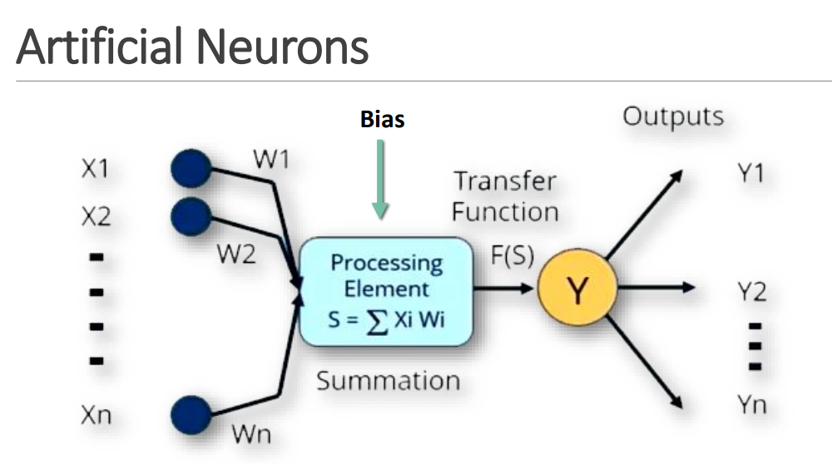

Slide 8
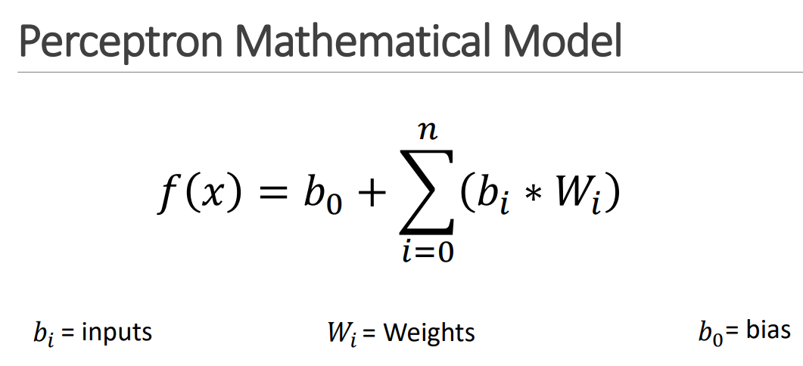

Slide 9
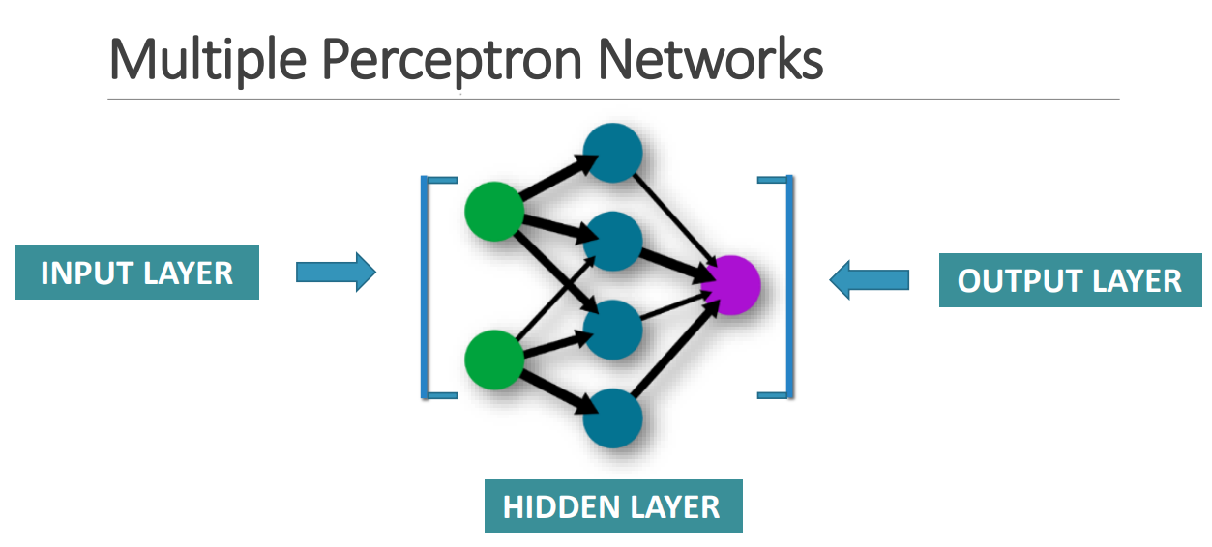

Slide 10
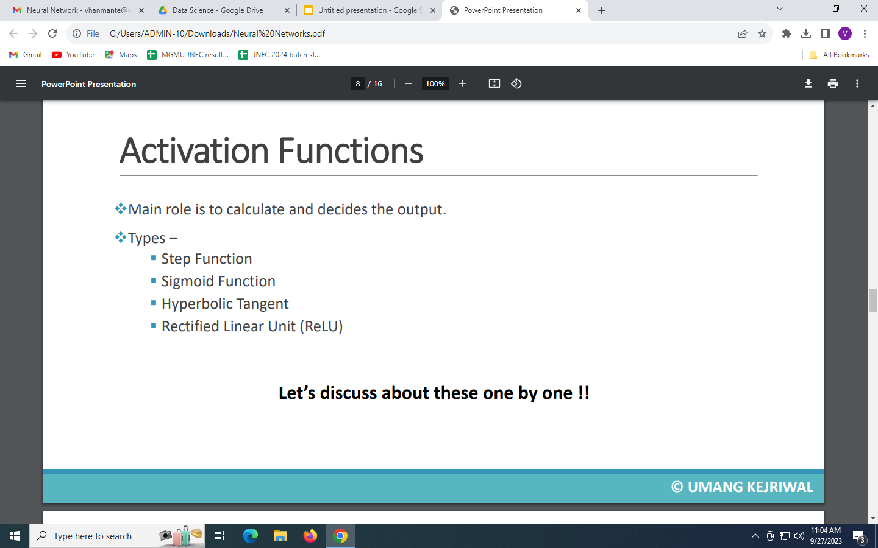
SoftMax

Slide 11
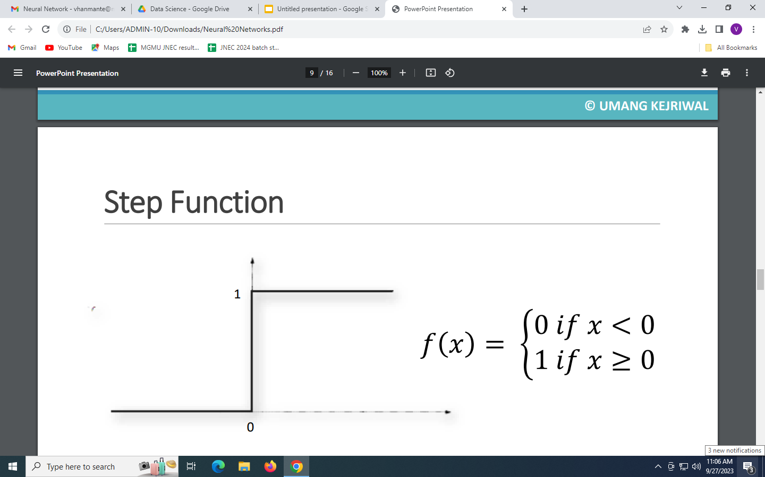
A unit step activation function is a much-used feature in neural networks.
The output assumes value 0 for negative argument and 1 for positive argument.
The output is binary in nature.

Slide 12
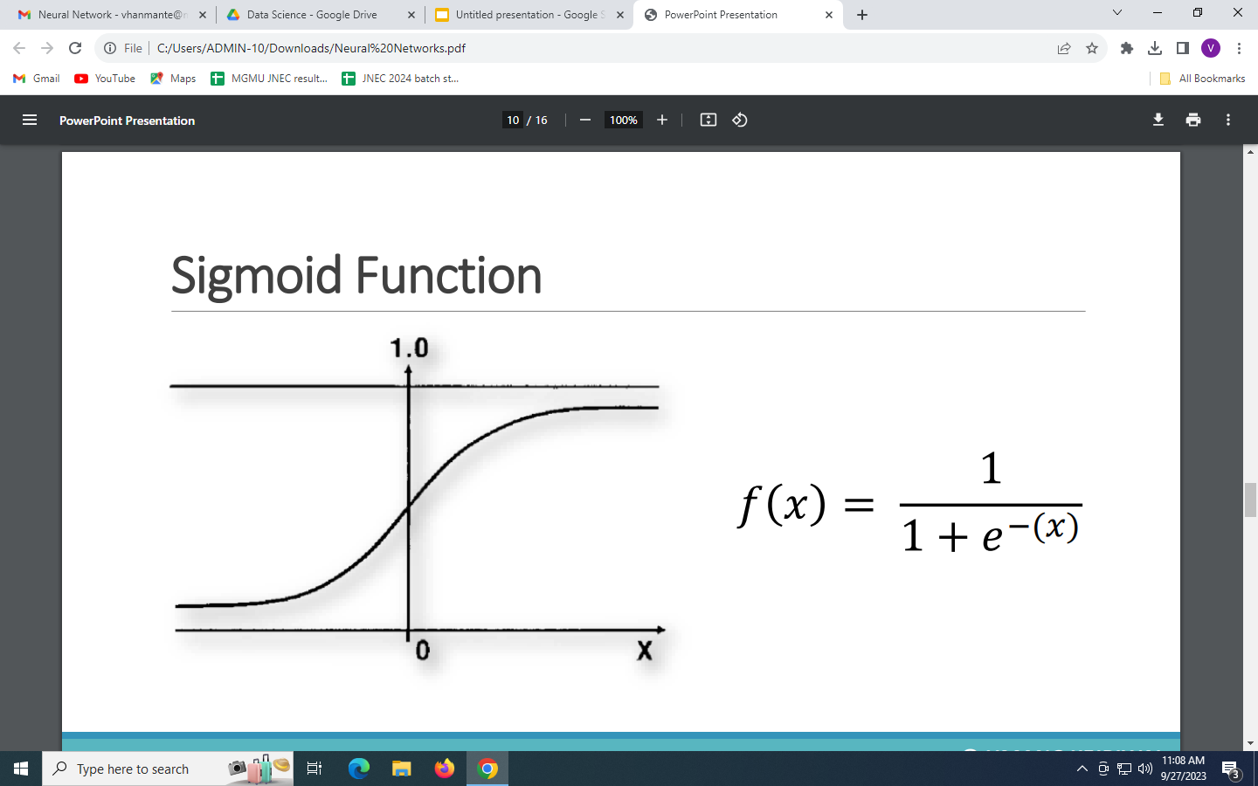
This function takes any real value as input and outputs values in the range of 0 to 1.
The larger the input (more positive), the closer the output value will be to 1, whereas
the smaller the input (more negative), the closer the output will be to 0

Slide 13
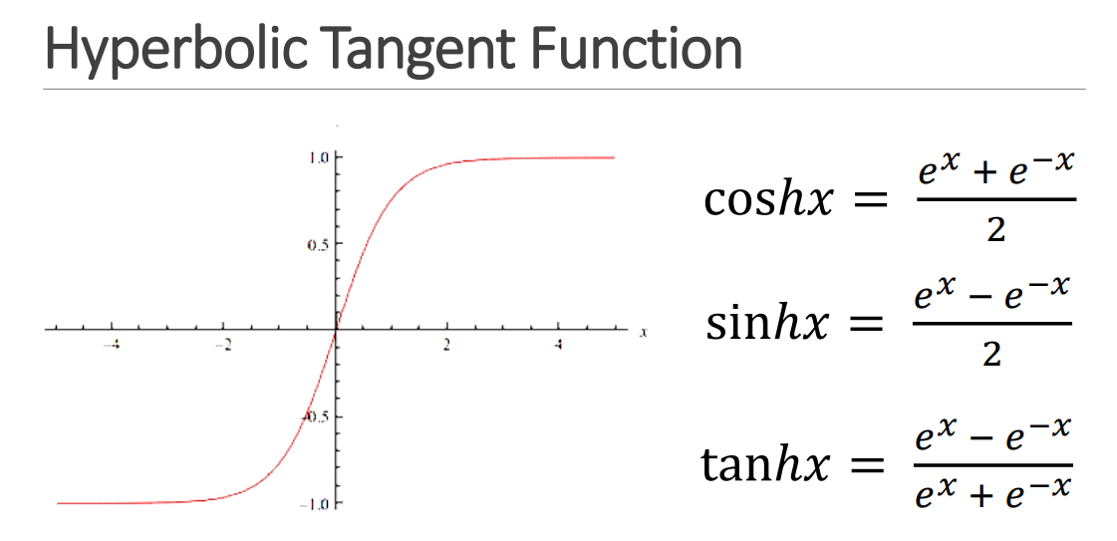
It is very similar to the sigmoid activation function and even has the same S-shape.
The function takes any real value as input and outputs values in the range -1 to 1

Slide 14
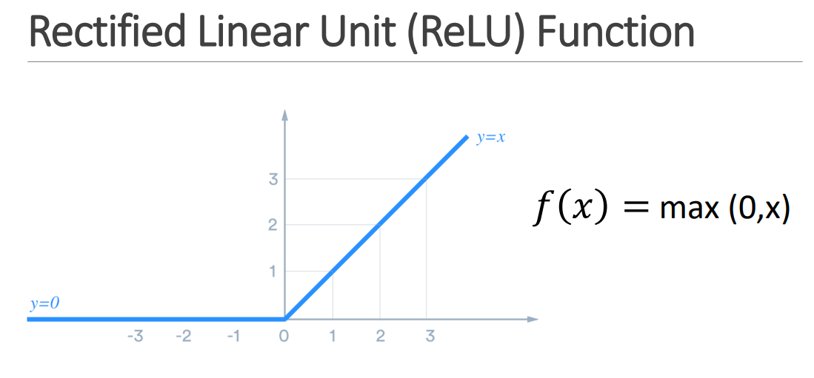
If the input value is positive, the ReLU function returns it; if it is negative, it returns 0.

Slide 15
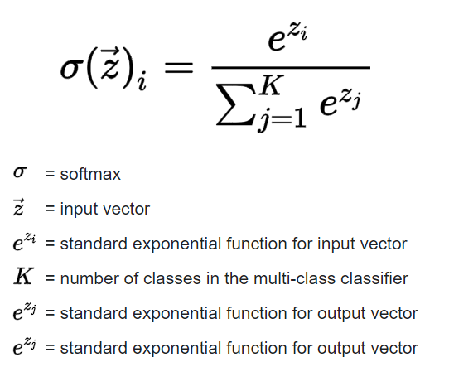
Softmax
The softmax activation function transforms the raw outputs of the neural network into a vector of probabilities, essentially a probability distribution over the input classes.
Used for multiclass classification problem with N classes.

Slide 16
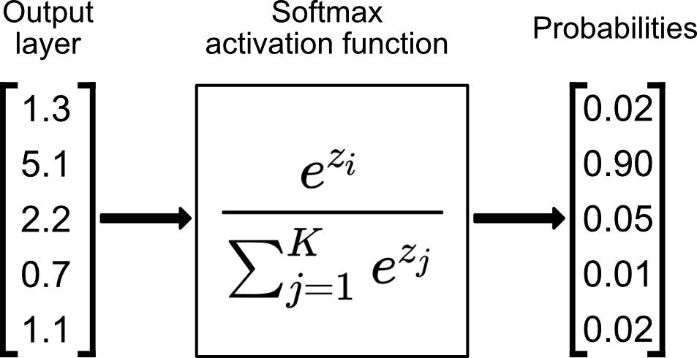

Slide 17
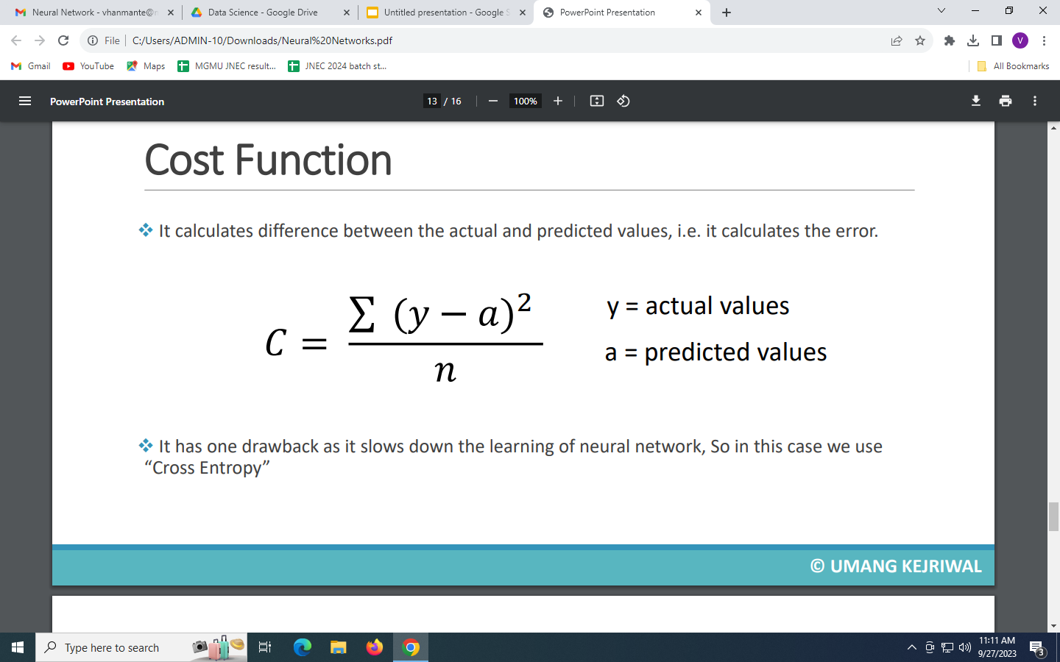

Slide 18
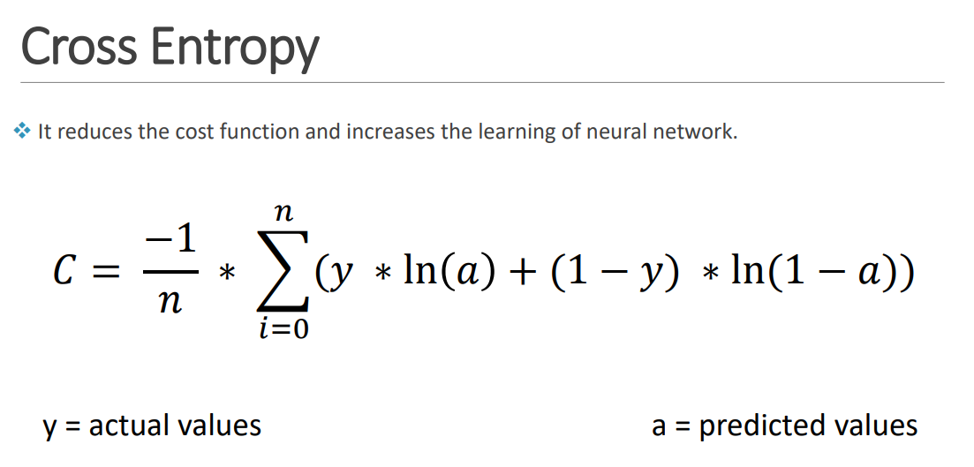

Slide 19
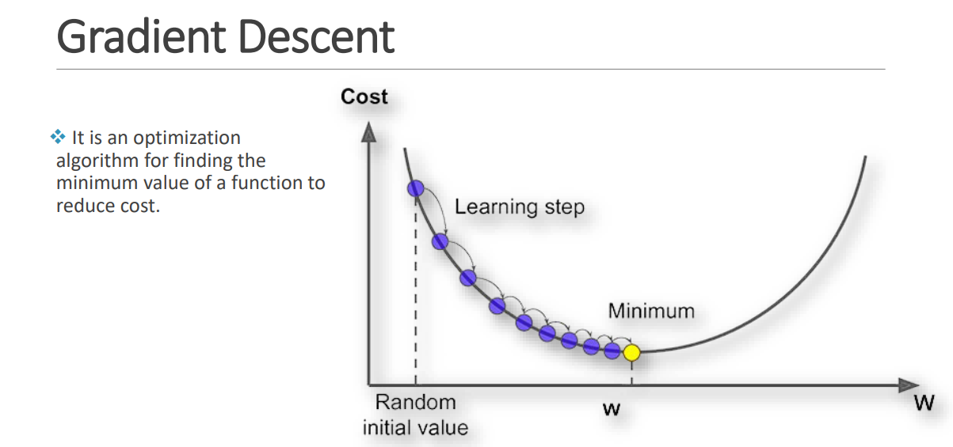

Slide 20
Gradient Descent is an optimization algorithm for finding a local minimum of a differentiable
function.
Gradient descent is simply used to find the values of a function's parameters
(coefficients) that minimize a cost function as far as possible.
Most machine learning and deep learning algorithms involve some sort of optimization.
Optimization refers to the process of either minimizing or maximizing some function by
altering its parameters.
With gradient descent, you start with a cost function (also known as a loss or error function)
based on a set of parameters. The goal is to find the parameter values that minimize
the cost function.

Slide 21
